Slide 1
5 STRIKES
XMILLS, SALAMAHN
OGUNRAIYEWA, OLUWATOBI

Slide 2
Goals And Objectives
‘5 Strikes’ is an educational game developed for the Android platform. The goal is to make an application that is not only fun but educational on many levels. The application is a tap the tiles style game that scrolls to the left. As the tiles scroll the user has to tap the next correct tile in the sequence. As time continues the speed of the scrolling will increase gradually along with a change in category.

Slide 3
Functional Requirements
Scoring system
Grid system
Health system
Power-up system

Slide 4
Non Functional Requirements
Difficulty option
Sound option
Vibration option
Time system
Ranking system
Background Music

Slide 5
Use Case
System | 5 Strikes
Use Case | Incorrect tile
Actors | Player
Description | Tapping one of the two incorrect tiles in the sequence.
Response | Decrement a health bar
Exceptions | correct Tile ‘tapped.
Actors
-User: player

Slide 6
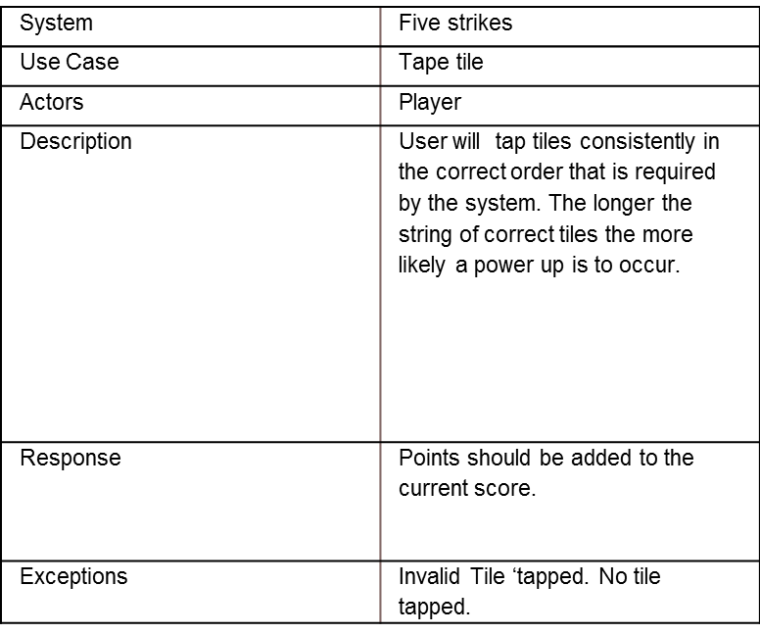
Use Case
User : Player

Slide 7
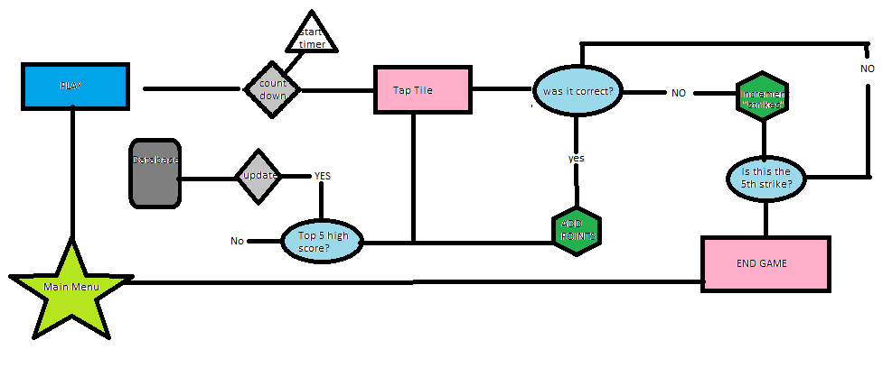
Architectural Design

Slide 8
Test Case
Test case | Verify | Authentication
‘3’ | correct | 64 points added to score
‘1’ | incorrect | Health bar lost
‘4’ | incorrect | Health bar lost
No tap | Not valid | Health bar lost
Tapping correct tile
Category: ‘π’
Correct tile: ‘3’

Slide 9
Test Case
Test case | Verify | Authentication
‘3’ | invalid
‘1’ | incorrect | Valid
‘4’ | incorrect | valid
No tap | invalid | valid
Tapping incorrect tile
Category: ‘π’
Correct tile: ‘3’

Slide 10
IN GAME REPRESENTATION
1
2
3
4
1.High Score
2.Score
3.Time
4.Count down timer
5.Health bar/Emoticon
6.Category
7.Tile Grid
5
7
6
Play screen

Slide 11
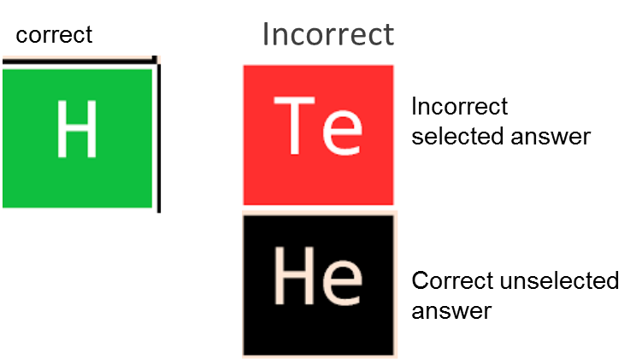
IN GAME REPRESENTATION
Tapping Tiles
Selecting the correct tile turns tile from default salmon to a emerald Green. Selecting an incorrect tile will turn selected tile Red and the correct unselected tile Black.
Correct
Selected
answer
Unselected
Tile

Slide 12
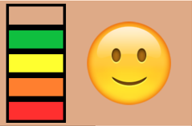
IN GAME REPRESENTATION
NO STRIKES
2 STRIKES
4 STRIKES
1 STRIKE
3 STRIKES
STRIKE OUT

Slide 13
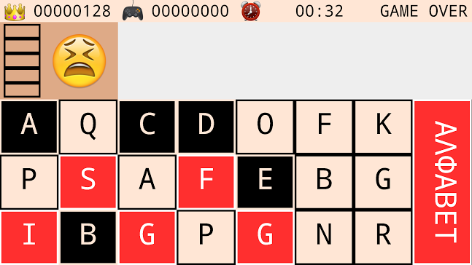
IN GAME REPRESENTATION
GAME OVER
5 Strikes mean a Strike Out. In the event a player Strikes Out the game is over.

Slide 14
OUTRO(constraints , concerns)
In developing 5 Strikes our two biggest constraints were the learning curve of the Android platform and the time we had to complete the project. This being the first time developing an app, a significant amount of time was spent debugging each piece of the program.

